Slide 1
BMC Remedy

Slide 2
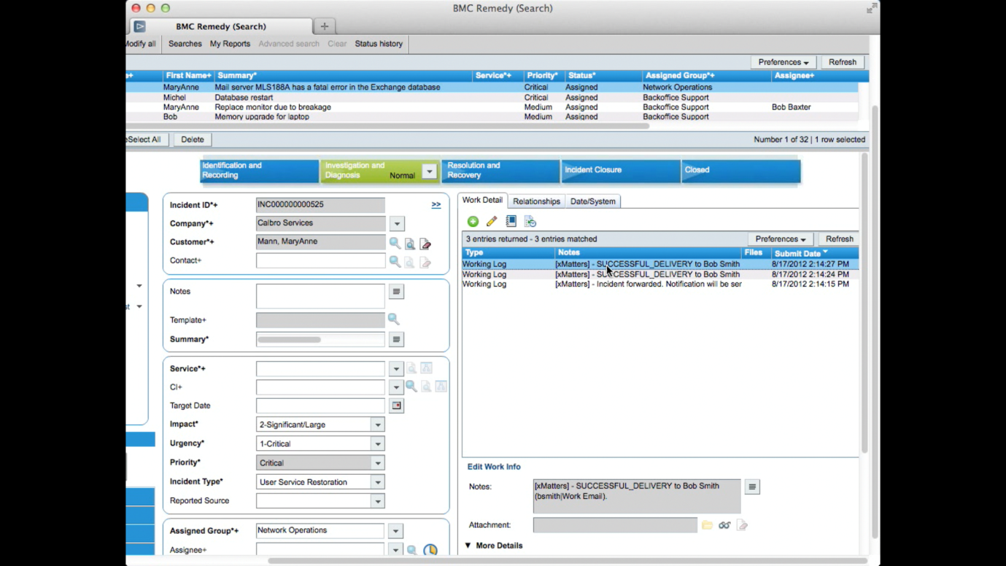
The mission of the incident management process is to resolve incident requests as quickly as possible in a prioritized fashion. The Incident Management module is designed to support this goal. These details are then made available to other applications, such as BMC Change Management.

